Slide 1
YouTube Usage
How my YouTube usage performed over 5 years
By Anthony “Nero” Lewis, 11/17/2023

Slide 2
Goal Manage YouTube app usage to an average of 3 hours per month
Objective:
Explore hourly differences across months
Explore part of day hourly usage
KPI:
Average hours
Total hours
Number of videos played

Slide 3






Data Flow
Process & clean data
Explore & analyze data
Create visualizations and do statistical analysis
Obtain data
Create story
Challenge 2
Challenge 3
ETL
Present findings

Slide 4
Challenges deep-dive
Challenge 1
Challenge 2
Challenge 3
How long do I watch videos on average?
The goal is to keep average video hours to around 3
When am I most active on YouTube?
Identify which seasons, months, and parts of day I am most active in 2023
Any noticeable patterns with app usage?
Explore and identify patterns or trends in the data

Slide 5
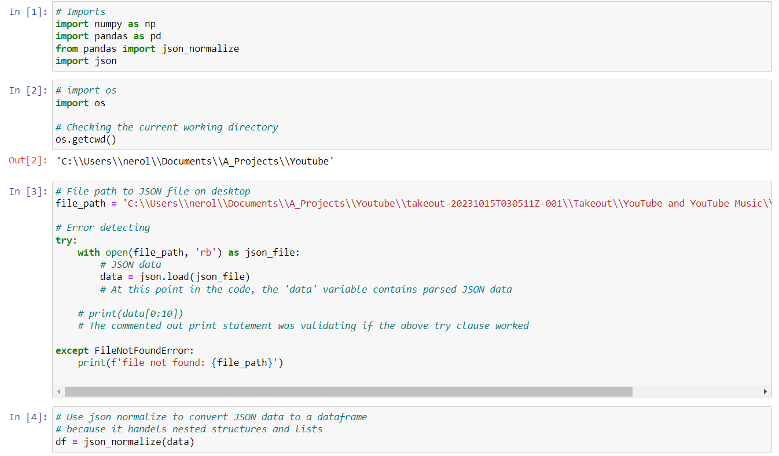
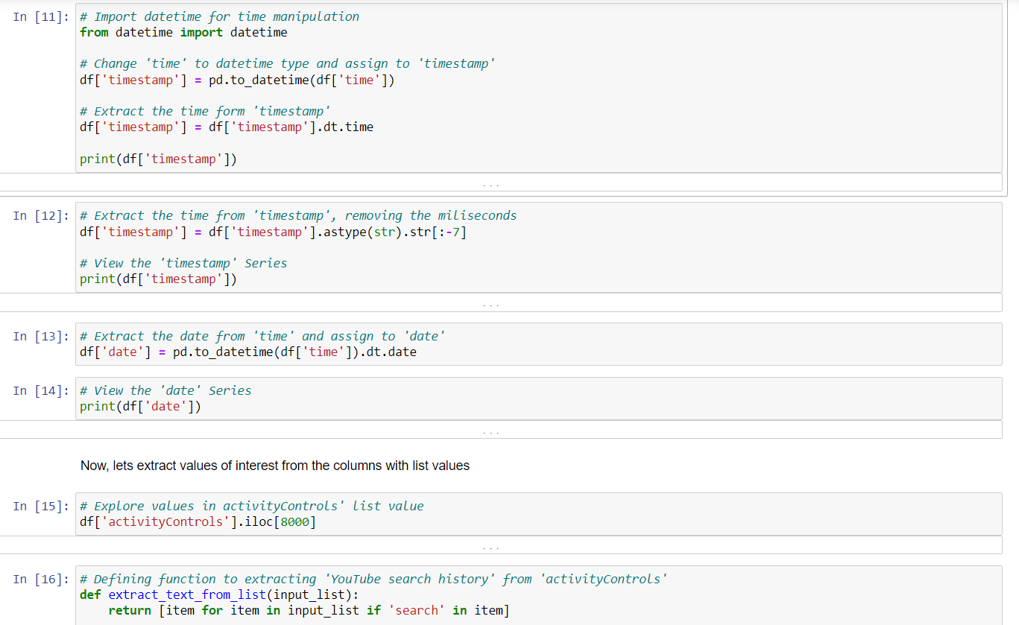
Processing and Cleaning
Used Python Jupyter Notebook to parse JSON
Formatted and restructured data

Slide 6
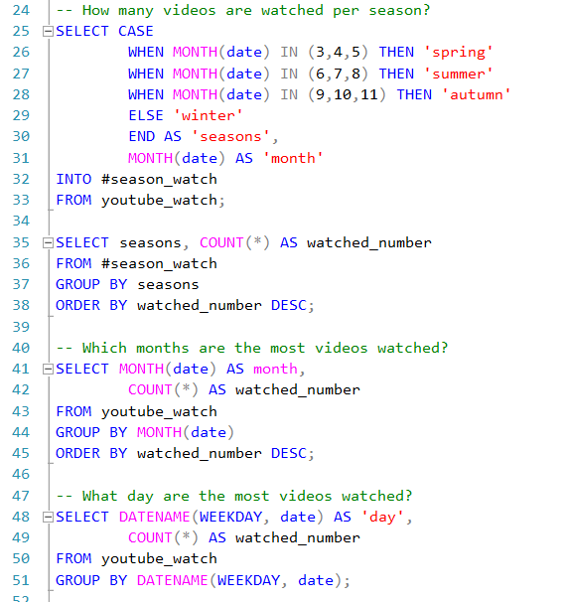
Exploration and Analysis part 1
Loaded data into SQL for
Monthly and seasonal time periods were explored

Slide 7
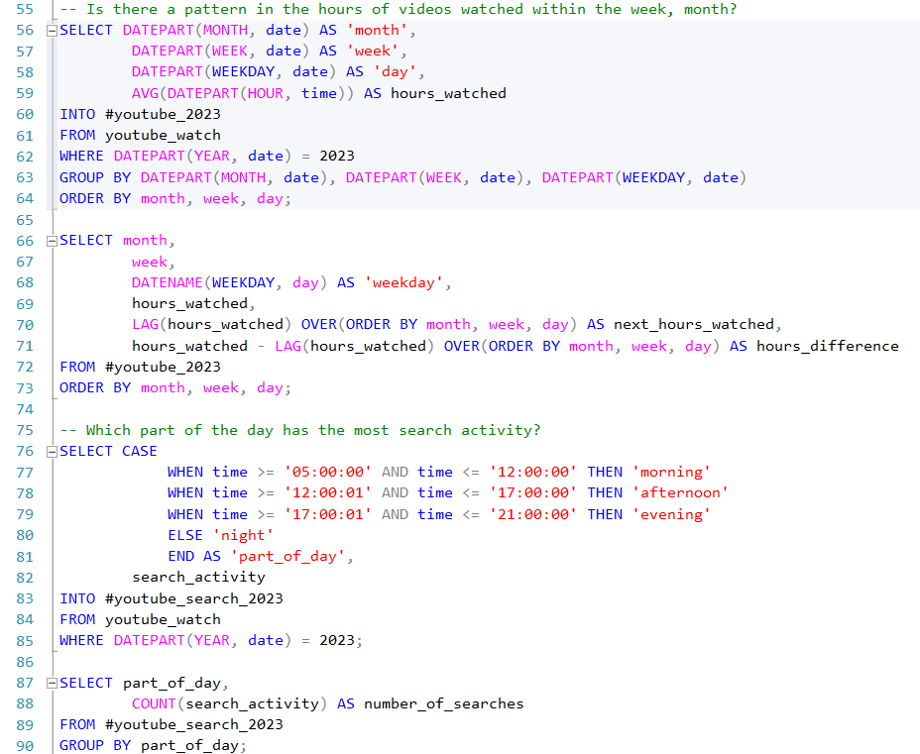
Exploration and Analysis part 2
Hourly differences were extracted and calculated before loading the data into Tableau

Slide 8
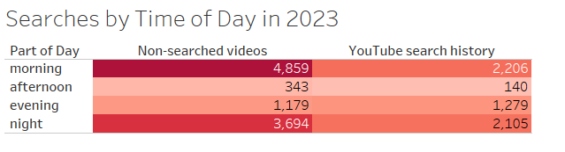
Part of Day Table
Frequency table for videos searched

Slide 9
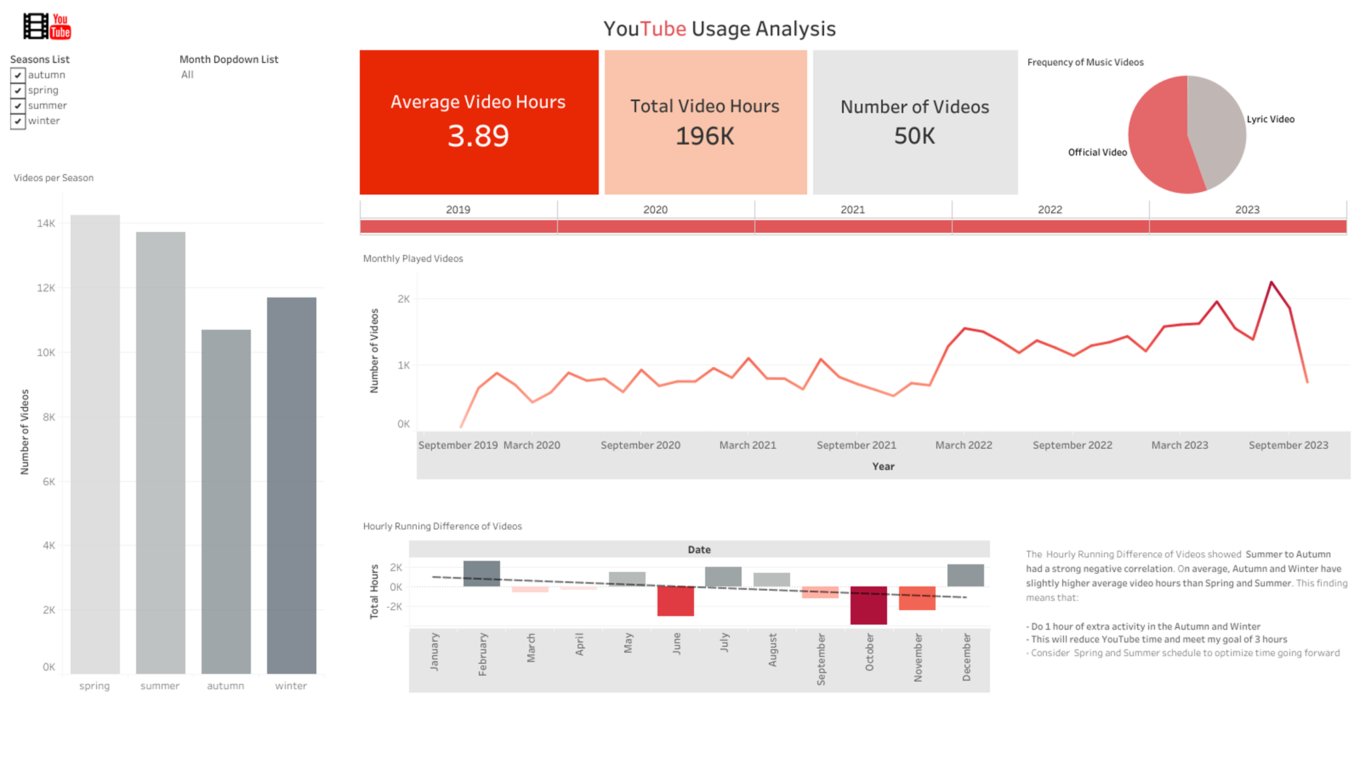
Findings Dashboard

Slide 10
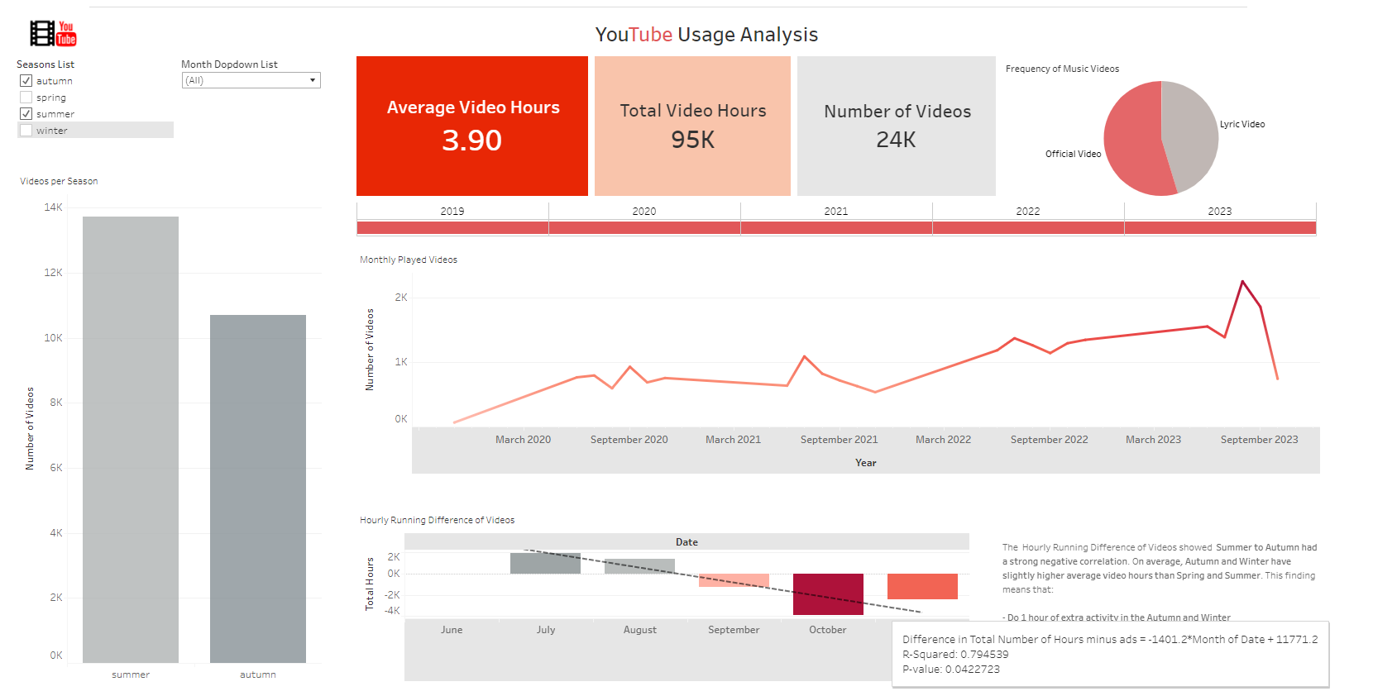
Insights
Autumn and Winter average hours of 4 slightly exceeded my goal of 3 hours
Morning and Night have highest usage in 2023
Summer to Autumn has a strong negative correlation (R-squared 0.79)

Slide 11
Recommendations

Slide 12
Autumn and Winter have an average of 4 hours, which should be reduced
Explore other activities to do for 1 hour in Autumn and Winter
Further explore Spring and Summer patterns to get ideas for Autumn and Winter usage adjustment schedule
Step 1
Step 2
Step 3
Step 4
Step 5
This 1 hour increase could be from online video lessons
Substituting 1 hour will reduce data usage and put Youtube usage at ideal level

Slide 13
Thanks for viewing
Questions and Answers
Feedback is welcome

Slide 14
References
Images:
https://commons.wikimedia.org/wiki/File:Tableau_Logo.png,Marissa-anna,https://en.wikipedia.org/wiki/en:Creative_Commons
https://commons.wikimedia.org/wiki/File:Microsoft_PowerPoint_Logo.png, UT Dallas, https://en.wikipedia.org/wiki/en:Creative_Commons
http://www.freepik.com">Designed by pikisuperstar / Freepik
https://www.nicepng.com/ourpic/u2q8r5r5a9t4u2w7_jupyter-logo/

